Slide 1
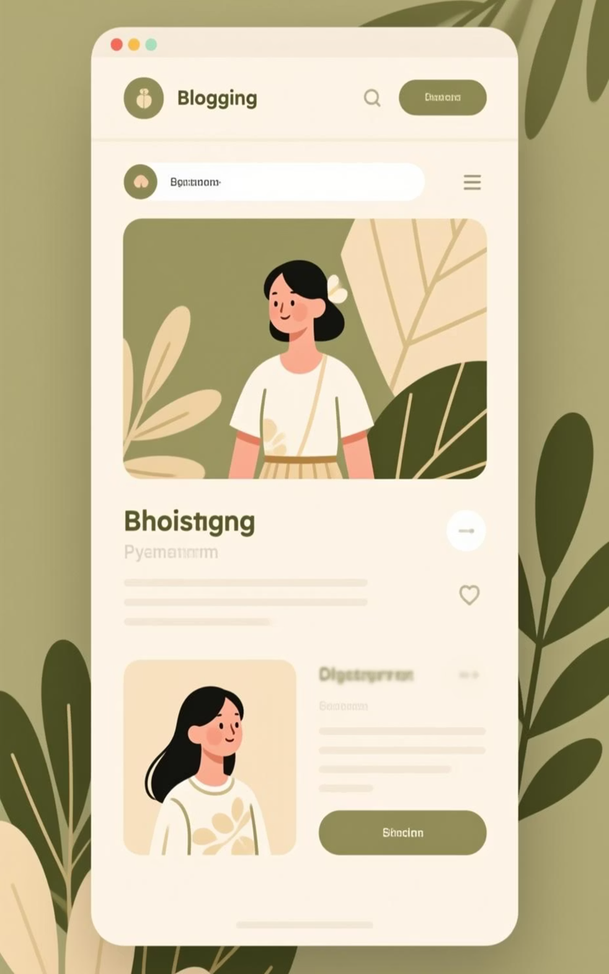
Online Blogging Platform
Empowering creators to share their stories with the world through intuitive, powerful tools designed for the modern web.

Slide 2
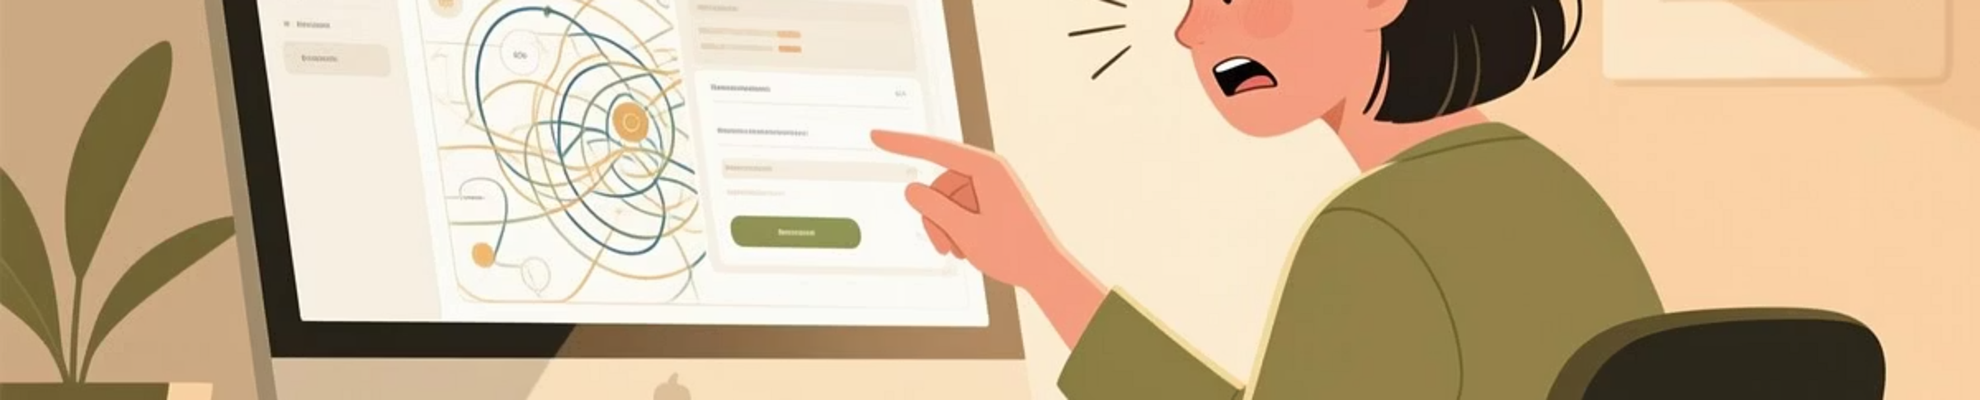
The Problem: Fragmented Blogging Experience
Disconnected Features
Limited Creative Tools
Weak Community Building
Existing platforms often lack seamless integration of core blogging features, forcing users to juggle multiple tools and workflows.
Users struggle with restrictive editing capabilities that don't support modern content creation needs like embedded media and formatting.
Poor interaction options and inadequate profile management prevent meaningful connections between creators

Slide 3
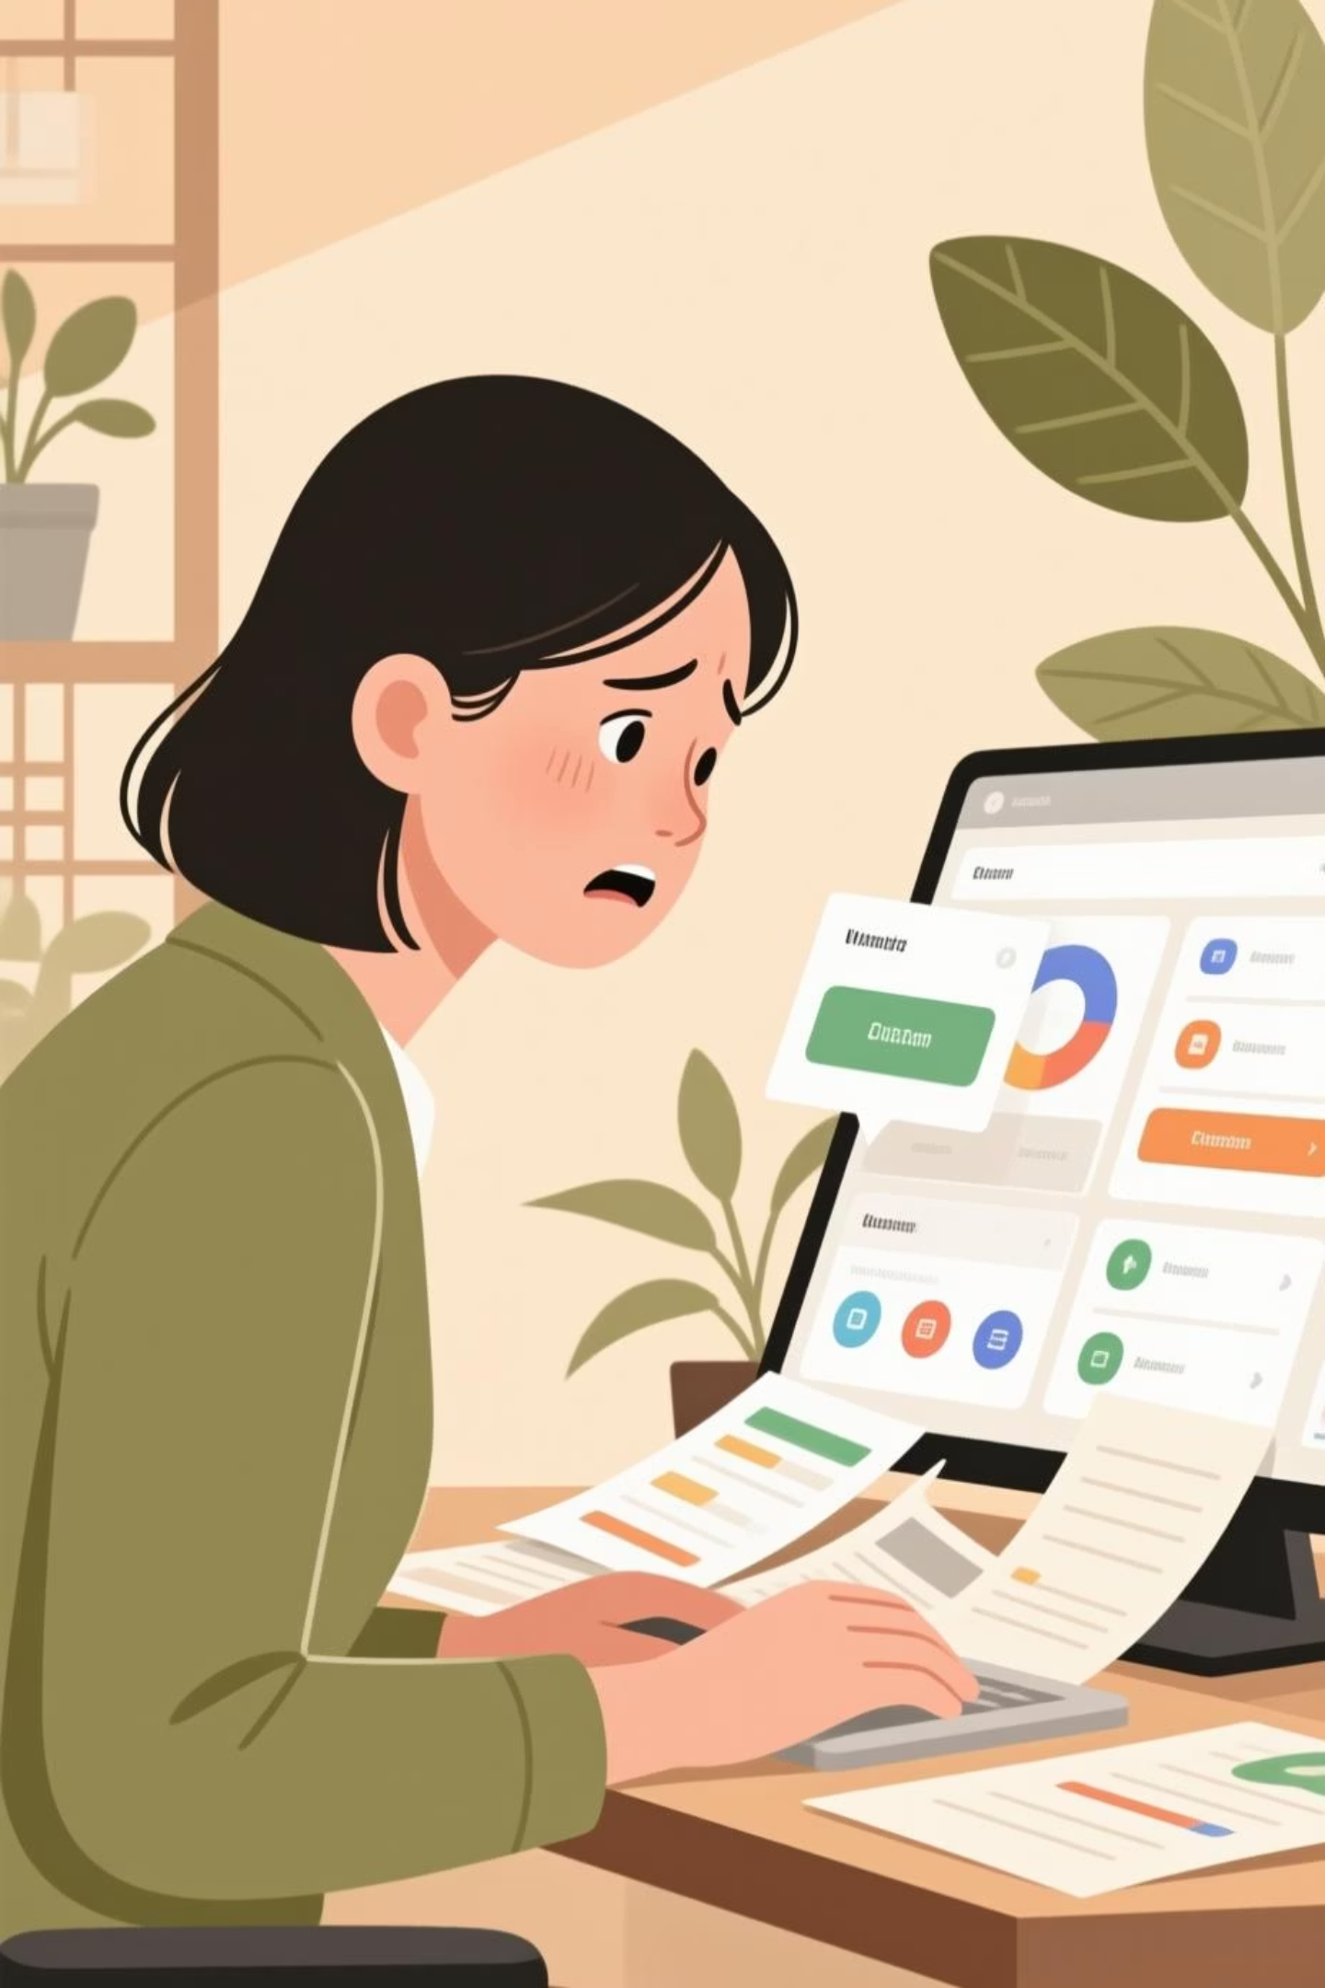
The Problem: User Engagement & Content Control Challenges
Content Management Pain Points
Community Interaction Gaps
Difficulty managing rich multimedia content across devices
Limited moderation capabilities for comments
Complex interfaces that slow down the creative process
Insufficien personalization of user profiles
Inadequate tools for organizing and categorizing posts
Poor visibility controls for managing content privacy

Slide 4



Our Solution: Overview
PlatformA reimagines blogging with an integrated ecosystem that puts creators first, combining powerful features with elegant simplicity.
Seamless Content Creation
Rich Text Editor
Profile Management
Create, edit, and delete blogs effortlessly with our intuitive interface designed for both novice and experienced writers.
Advanced editing tools supporting multimedia content, formatting options, and embedded elements for dynamic, engaging posts.
Robust customization options allowing users to build their brand

Slide 5





Key Features: Interactive & Social
Likes System
One-click appreciation that helps surface quality content and rewards creators with instant feedback from their community.
Comments & Discussions
Threaded commenting system enabling rich conversations, with moderation tools to maintain healthy community interactions.
Real-Time Notifications
Stay connected with instant updates on likes, comments, new followers, and content milestones to maintain engagement momentum.
User Roles & Permissions
Flexible permission system allowing content moderation, team collaboration, and granular control over who can interact with your content.

Slide 6



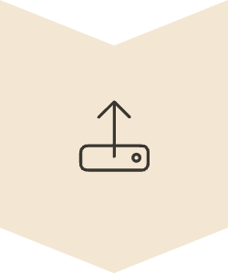
User Journey: From Registration to Community
We've designed every touchpoint to be intuitive, empowering users to focus on what matters most—creating great content.
Sign Up
Quick registration with profile setup
Create Blog
Use rich editor to craft compelling posts
Preview & Edit
Review and refine before publishing
Publish
Share with your audience instantly

Slide 7
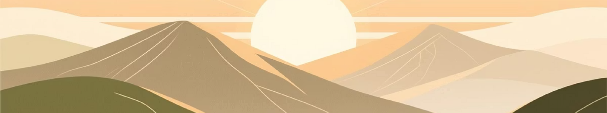
Empowering Bloggers with BlogCraft
PlatformA transforms blogging into a seamless, interactive, and personalized experience—where your voice matters and your community thrives.
Create Without Limits
Connect Authentically
Inspire the World
Powerful tools that adapt to your creative vision
Build meaningful relationships with engaged readers
Share your unique perspective and make an impact
Ready to transform your blogging experience? Join Blogcraft today and be part of the future of online storytelling.

Slide 8
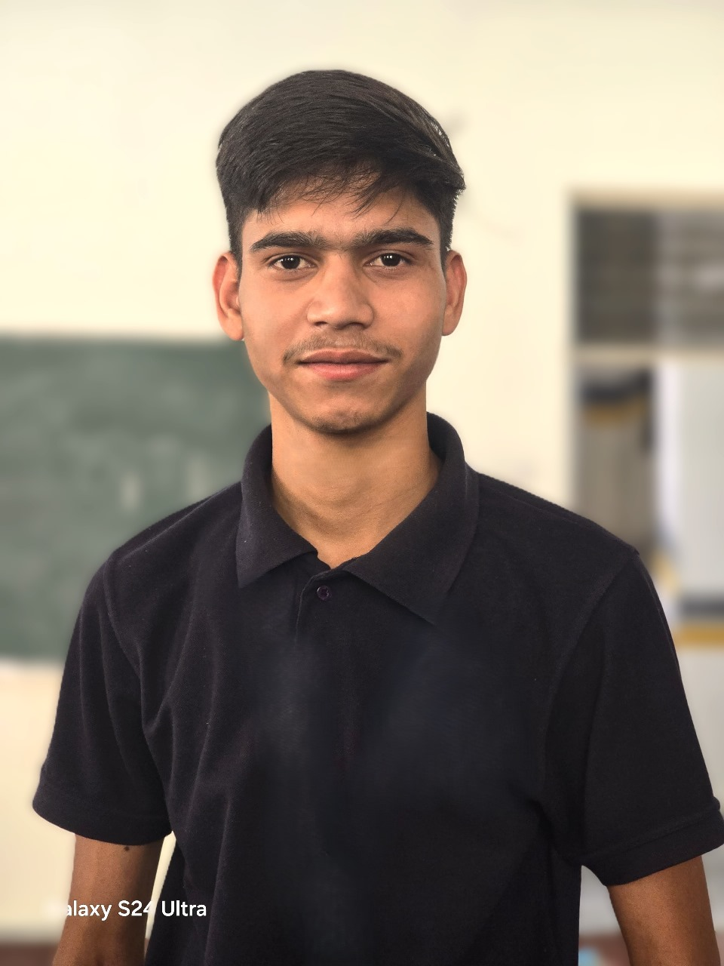
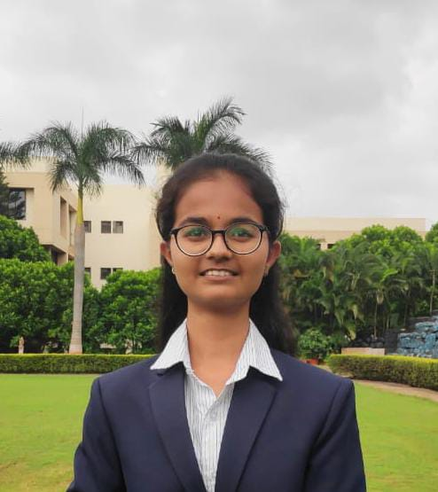
Team Members
Name:-Khemchand Prajapat
Name:-Renuka Joshi
Email id:-khemchand730030@gmail.com
Email id:-renukajoshi1064@gmail.com

Slide 9
Thank You!!

